Slide 1
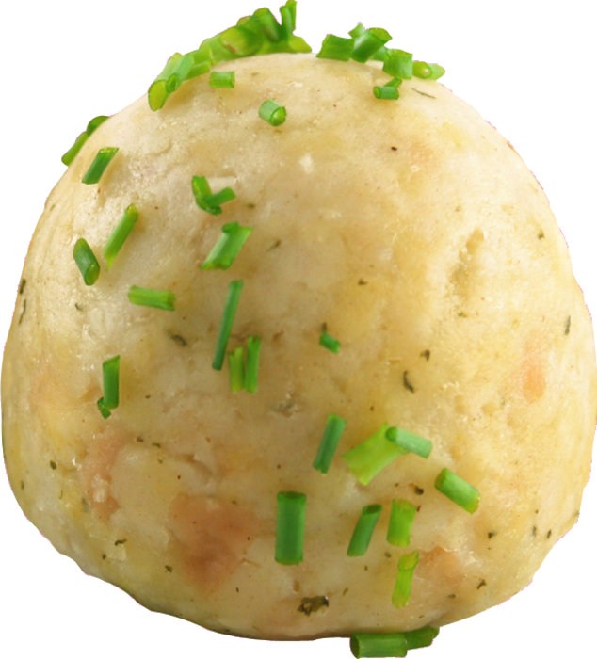
Quantizing KNOEDEL
An Knowledgible Efficient Detector of Edible Loveliness

Slide 2
Network Structure
3 times conv layer -> one fullyconnected layer

Slide 3
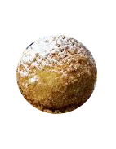
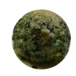
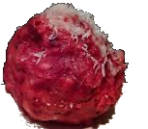
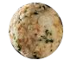
Convolutional Neural Network

Slide 5
Convolutional Layer 3 mal kernel 3 stride 2 64x64 -> 8x8
Fully connected mit 2 outputs

